Slide 2



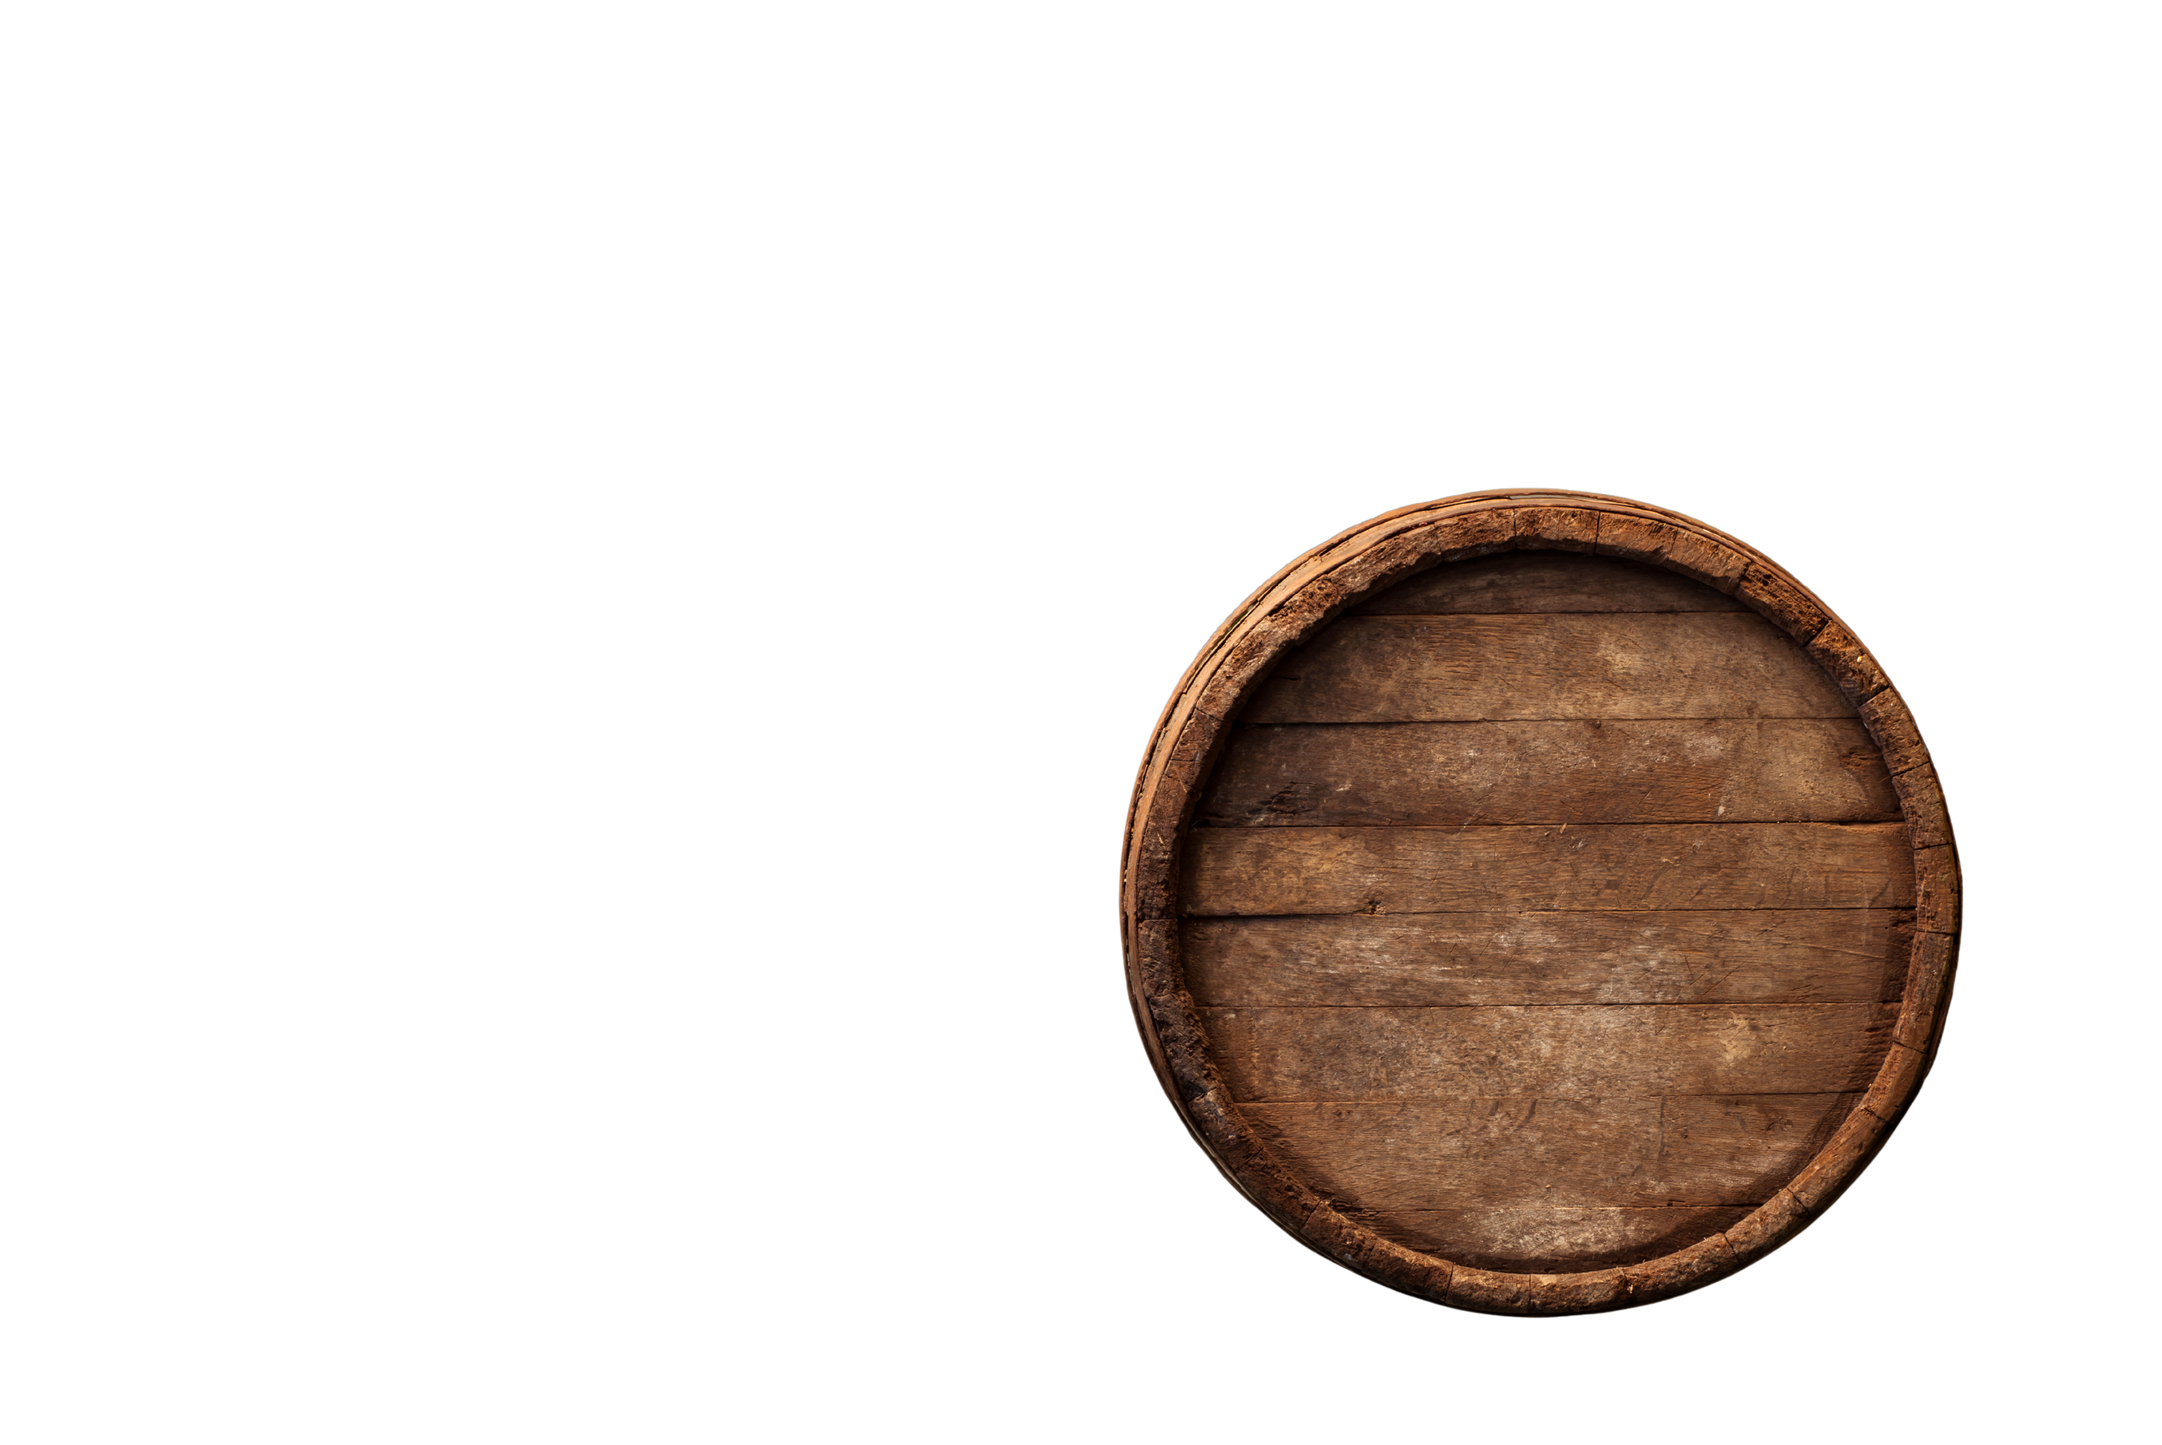
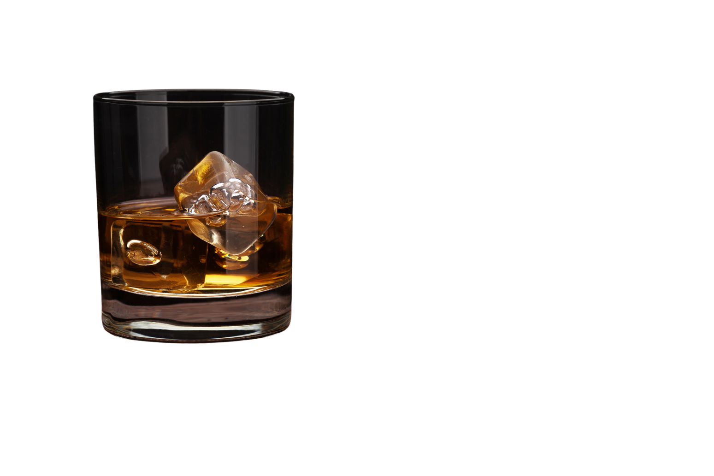
Sunflowers
&
Whiskey
Sunflowers
An Upscale Whiskey Bar in Kansas City
&
Kansas Born,
Whiskey
Tennessee Distilled..
Presented by: Dicarlos McNeely
(C.M. James)

Slide 3
Brief introduction of
Sunflowers & Whiskey
Welcome to Sunflowers & Whiskey
Sunflowers & Whiskey is an upscale whiskey bar and live music venue that brings both cultures, the soul of Kansas City and the Tennessee Southern roots together. Located in Kansas City, Kansas, this venue is set to become a premier destination for music lovers, whiskey enthusiasts, and community gatherings.
Why Are We Here?
We are seeking strategic sponsorships and community partnerships to bring this unique concept to life. With Kansas City’s growing entertainment industry and the upcoming FIFA 2026 World Cup, Sunflowers & Whiskey presents an incredible opportunity for sponsors to align with a high-value, culturally significant business.

Slide 4
What This Presentation Will Cover
-Business Concept: What makes Sunflowers & Whiskey unique.
-Market & Competitive Edge: Why Kansas City needs a Nashville-inspired whiskey bar.
-Financial & Sponsorship Opportunities: How businesses can benefit from investing.
- Community & Economic Impact: How Sunflowers & Whiskey will contribute to Kansas City.
-Call to Action: Next steps for sponsorship and collaboration.
By the end of this presentation, we hope to engage strategic partners and sponsors who share our vision and want to be part of an exciting new chapter in Kansas City nightlife.

Slide 5
Vision & Concept
  Sunflowers & Whiskey is a Nashville-style whiskey bar and live music venue in Kansas City, KS.
  Mission: To provide an upscale whiskey experience while honoring Larysa Jaye.
  Features: Live music, whiskey tastings, and exclusive artist showcases.

Slide 6
Business Concept & Offerings
  Premium Whiskey Selection: Diverse craft cocktails and whiskey brands.
  Live Music & Writers’ Rounds: Featuring local and national artists.
  Themed Events & Private Gatherings:
Album release parties
Corporate events

Slide 7
Location & Venue Details
Address: 13 N 8th Street, Kansas City, KS 66101
Size: 6,795 sq. ft. (0.16 acres)
Capacity: 80-120 guests
Proximity: 5 minutes from downtown Kansas City, MO
Zoning: Commercial (Ideal for a whiskey bar & music venue)

Slide 8
Market Analysis & Competitive Advantage
Market Demand:
No direct competitors in Kansas City, KS.
Competitive Edge:
    Nashville-style whiskey bar
    Unique artist-driven experience
    Ties to FIFA 2026 tourism boom
Target Audience:
Professionals, music lovers, tourists

Slide 9
Community & Cultural Impact
Job Creation:
30+ new jobs in hospitality & entertainment.
Supporting Black & Multicultural Artists:
A dedicated performance space.
Revitalizing the Local Economy:
Contributing to the cultural scene in KCK.

Slide 10
FIFA 2026 Economic Opportunity
  Projected $652 million impact in Kansas City during FIFA 2026.
  High tourism influx benefiting local businesses.
  Sponsor Benefits: Increased brand visibility through FIFA-related marketing.

Slide 11
Investment & Financial Plan
Total Estimated Cost: $725,000 - $925,000
Expense Breakdown:
    Construction & Renovation: $300,000 - $400,000
    Interior & Theming: $75,000 - $150,000
    Bar Equipment & Sound System: $50,000 - $75,000
    Liquor Inventory: $50,000
    Licenses & Permits: $25,000 - $50,000
    Marketing & Branding: $25,000 - $50,000
    Operating Capital: $100,000 - $150,000

Slide 12
Funding & Sponsorship Opportunities
  Private Investors & Equity Partnerships
  Economic Development Incentives
  (Wyandotte County programs)
  Minority Business Grants & Loans
  Corporate & Local Business Sponsorships

Slide 13
Development Timeline
  Q2 2025: Secure Funding & Investor Commitments
  Q3-Q4 2025: Permitting & Construction
  Q1 2026: Staff Hiring & Training
  Q2 2026: Soft Opening & VIP Events
  Grand Opening: Before FIFA 2026

Slide 14
Why Partner with Sunflowers & Whiskey?
  First-of-its-kind Nashville-inspired whiskey bar in KCK.
  Tied to FIFA 2026 for global brand exposure.
  Community & Cultural Impact—Supporting minority artists.
  A profitable investment opportunity in the city's growing nightlife.

Slide 15
Call to Action – Join Us Today!
  Become a sponsor and be part of this landmark project.
  Exclusive branding & marketing benefits.
  Help build Kansas City's next great live music venue.
  Contact Information:
    Dicarlos McNeely (C.M. James)
    Phone: 615-751-0923
    Email: contact@CMJayeMusic.com
    Website: CMJayeMusic.com

Slide 16
Sunflowers
&
Whiskey

